Slide 1
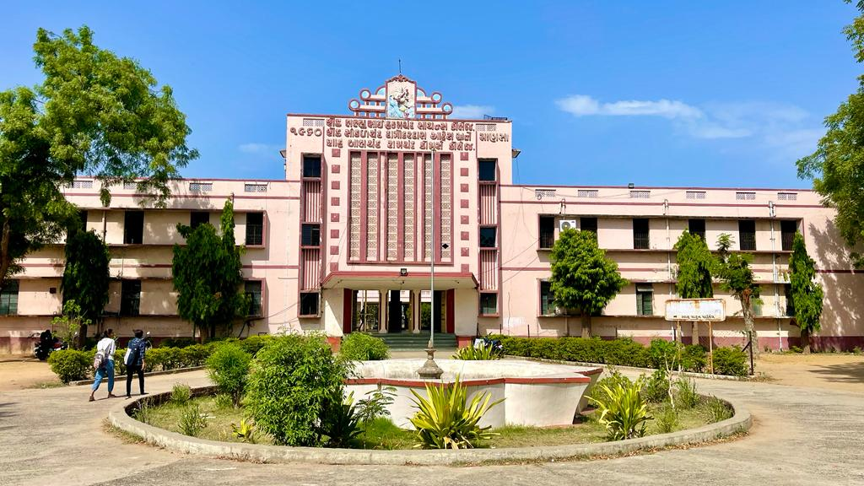
S.D.Arts and Shah B.R.Commerce College, Mansa

Slide 2
GUJARAT UNIVERSITY
B.A. (HONS) SEMESTER 2
ELECTIVE-112
WORLD HISTORY (1815 TO 1870 AD)

Slide 3
Unit 1
Vienna conference
European Union

Slide 4
UNIT 2
A. French Revolution of 1830 AD
B. French Revolution of 1848 AD

Slide 5
Unit 3
Industrial Revolution : Meaning and Definition
Industrial Revolution : Causes
Industrial Revolution : Political, Social & Economic Effects

Slide 6
Unit 4
Meiji Age in Japan
Meiji Constitution and Administration
Modernization of Japan during Meiji

