Slide 1
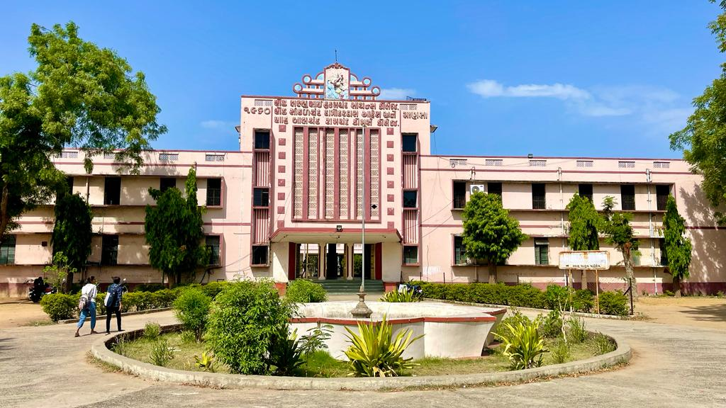
S.D.Arts and Shah B.R.Commerce College, Mansa

Slide 2
GUJARAT UNIVERSITY
B.A.SEMESTER 1
ELECTIVE (EC1 101)
Ancient India: History , archaeology and Culture (Pre History to 6th cent. BC)

Slide 3
Unit 1
Vienna conference
European Union

Slide 4
UNIT 1
1. Sources for studying Indian History
Archaeological Sources
Literary Sources
2. Prehistory of India
Palaeolithic Culture
Mesolithic Culture
Neolithic Culture

Slide 5
UNIT 2
1. Aspects of Harappan Civilization
Town Planning ,
Economic condition
Religion and Culture
Relationship with other Civilization
Decline and Views
Contribution of Harappan
Civilization to India and world

Slide 6
Unit 3
1. Rigvedic Period:
Political System
Society
Religion
Position of Women
2. Later vedic Period
Literature : Samveda, Athrvaveda, Yajurveda, Brahmangranths,
Aryankas, Ramayana and Mahabharata, Puranas and Dharmshastra , Upnishadas
Political System
Society
Economic Condition
Religion
Change in Position of Women

Slide 7
Unit 4
1. Gautam Buddha : Life and work As a Reformer
2. Mahavira Swami : Life and Work As A Reformer
3. Political Situation in the 6th Cent. BC
16 Mahajanapadas and Rise Of Magadha
Haryaka Dynasty , Naga Dynasty and Nanda Dynasty

