Slide 1
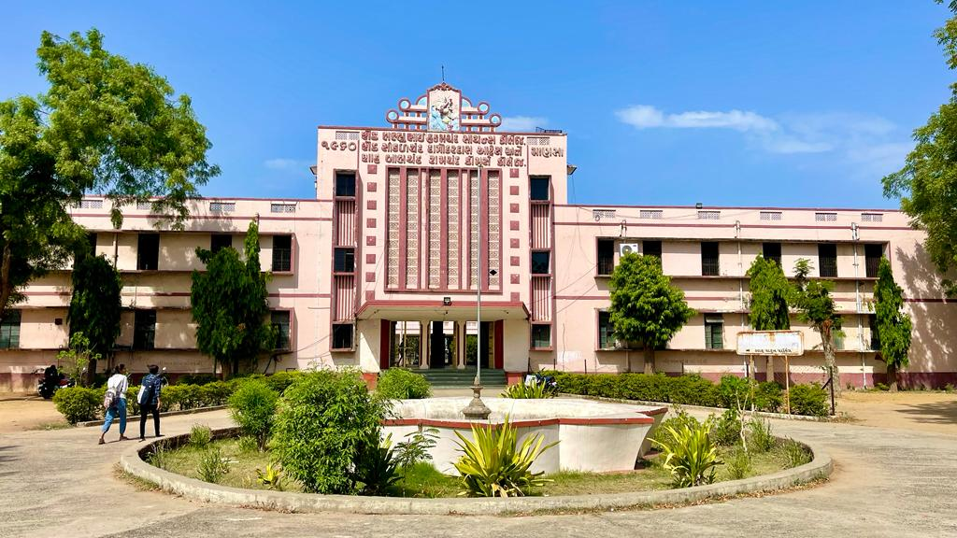
S.D.Arts and Shah B.R.Commerce College, Mansa

Slide 2
GUJARAT UNIVERSITY
B.A.SEMSTER 1
ELECTIVE (EC1 102)
World History (From Renaissance to French revolution)

Slide 3
Unit 1
Renaissance
Meaning of renaissance
Factors leading to Renaissance
Impact on Literature, Art , Architecture and Science
Religious Reformation
Factors Leading to reformation
Major Reformers
Erasmus
John Huss
Martin Luther
3. Results Of religious Reforms

Slide 4
UNIT 2
Gegraphical Discoveries
Factors responsible for Geographical discoveries
Marco Polo, Columbus , Vasco-de-Gama, Henry the Navigator
Results of geographical Discoveries

Slide 5
Unit 3
Blood less Revolution of England (1688 A.D.)
Causes and Its impact on British Constitution
Bill Of Rights and its importance

Slide 6
Unit 4
American Revolution (1776) : Causes and Results
Leaders of Amercian Revolution
French Revolution (1789) : Causes and Results
Napoleon Bonaparte

