Slide 1
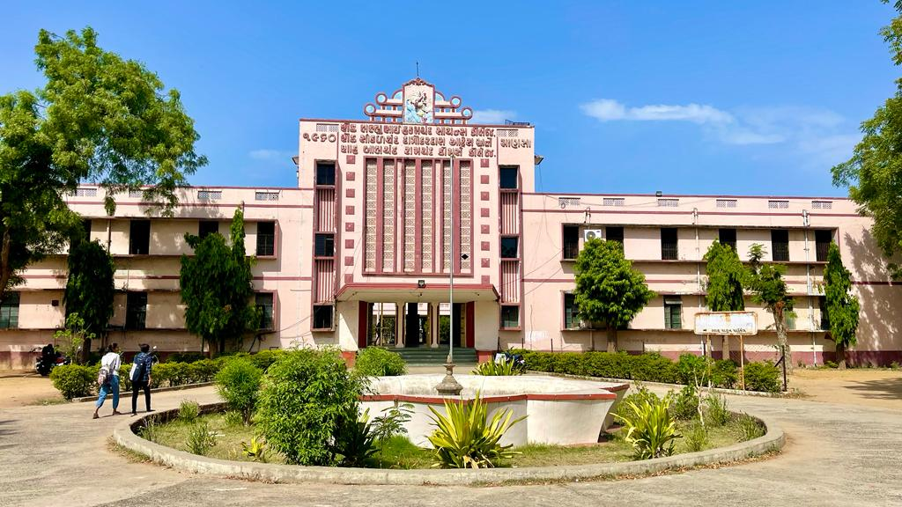
S.D.Arts and Shah B.R.Commerce College, Mansa

Slide 2
GUJARAT UNIVERSITY
B.A.SEMSTER 1
ELECTIVE (EC1 103)
INDIAN CULTURE AND HERITAGE

Slide 3
Unit 1
Salient features of indian Culture

Slide 4
UNIT 2
Harappan Civilization
Cultural Heritage of Vedic Period

Slide 5
Unit 3
Later Vedic Culture : Epics, Puranas and Upanishadas
Gautam Buddha and Mahavira Swami : Life and Work

Slide 6
Unit 4
Art and Culture of Mauryan Period
Art and Culture of Post-Mauryan period
Art and Culture of Gupta Period

