Slide 1
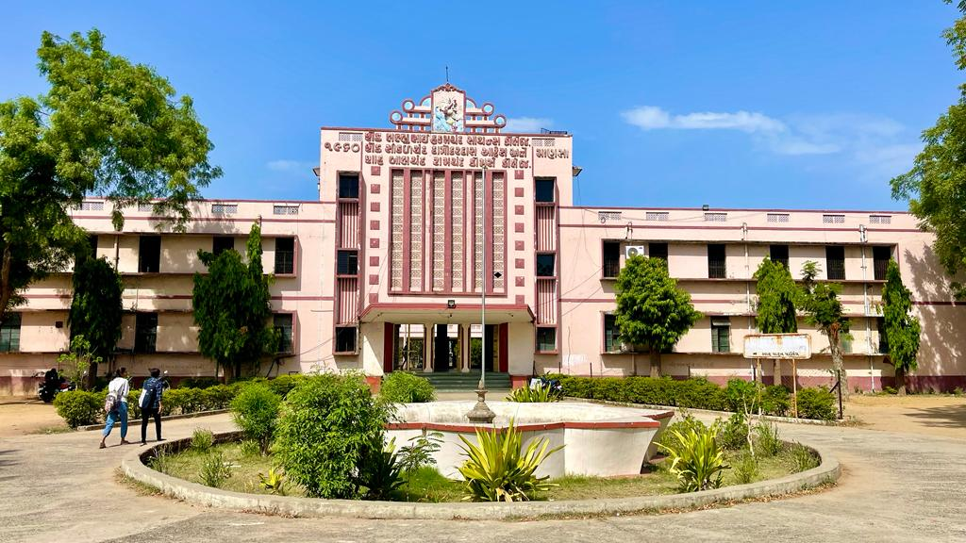
S.D.Arts and Shah B.R.Commerce College, Mansa

Slide 2
GUJARAT UNIVERSITY
B.A. (HONS) SEMESTER 2
ELECTIVE-2-113
INDIAN CULTURE AND HERITAGE

Slide 3
Unit 1
Educational Institutes in india: Taxila, Nalanda, Valabhi
Art and culture during the Rajput age
Cultural achievements of Satavahanas, Pallvas, Cholas and Vakatakas

Slide 4
UNIT 2
Art and culture of Sultanate age
Bhakti and Sufi movements

Slide 5
Unit 3
Cultural Achievements of the Mughals
Developments of Science and Technology
during the Mughal Period

Slide 6
Unit 4
Art and culture of Vijaynagar Empire
Art and culture of Bahamani Kingdom

