Slide 1
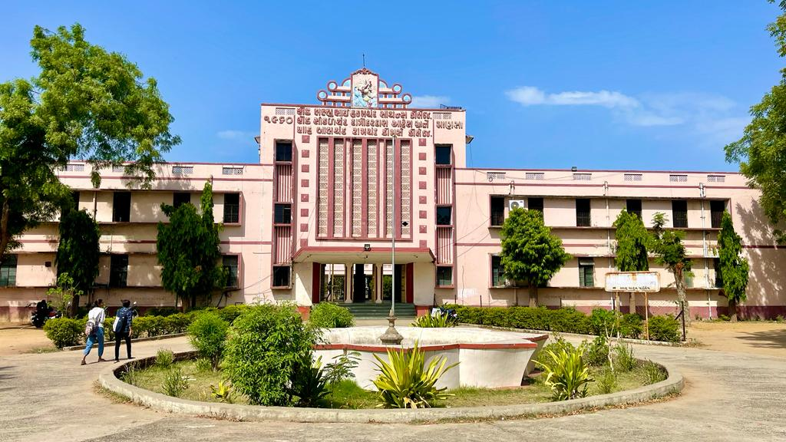
S.D.Arts and Shah B.R.Commerce College, Mansa

Slide 2
GUJARAT UNIVERSITY
B.A.SEMSTER 4
ELECTIVE (EC1 211)
History of India – 1526 to 1757

Slide 3
UNIT 1
The first Battle of Panipat _ 1526
Sher Shah Soor – Internal policy and reforms
Akbar- Rajput and religious policy.
Jahangir.

Slide 4
UNIT 2
Mughal Administration – Mansabdari system
Shahjahan and Aurangzeb.
Cultural Achievements of Mughals.
Decline of Mughal.

Slide 5
Unit 3
Rise of Maratha power in India
Chhatrapati Shivaji – Life and Achievements.
The peshwa –Bajirao 1st and Balajibajirao.
3rd Battle of panipat and decline of Maratha power.

Slide 6
Unit 4
European Companies in India – Portugal
Dutch, English and French.
2. Anglo-Dutch and Anglo-French wars.
3. Anglo-maratha wars.

