Slide 1
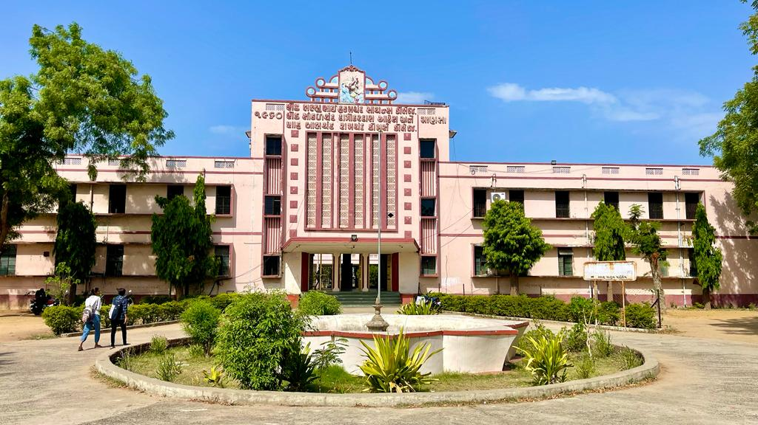
S.D.Arts and Shah B.R.Commerce College, Mansa

Slide 2
GUJARAT UNIVERSITY
B.A.SEMSTER 4
ELECTIVE (EC1 212)
World Hisrory – 1919 to 1990

Slide 3
Unit 1
World between two world wars
Internal and external policy of Mussollini.
Internal and external policy of Hitler.
Russia During Stallin Age.

Slide 4
UNIT 2
– The Second World War
Causes of Second World War.
Impact of Second World War.
Chinese Revolution of 1949.

Slide 5
Unit 3
– United Nations
Aims of UN
Organs of UN
Contribution of Un in World peace.

Slide 6
Unit 4
– World after Second World War
Cold War – Incidents, Causes and effects.
The Non Alignment Movement.
End of.Cold War – Cause and effect.

