Slide 1
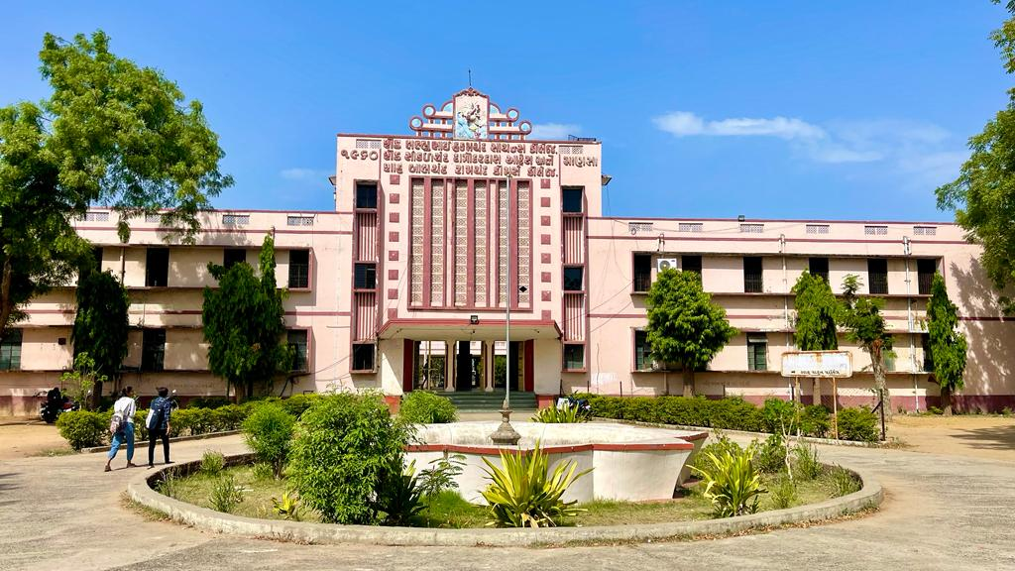
S.D.Arts and Shah B.R.Commerce College, Mansa

Slide 2
GUJARAT UNIVERSITY
B.A. SMESTER 3
ELECTIVE (EC 201)
HISTORY OF INDIA (FROM 650 A.D. TO 1206A.D.)

Slide 3
UNIT 1 post Gupta Era
The Kanauj
Gurjar Pratiharas of Rajsthan
Gadhvals
Tomars
Chauhanas of Delhi

Slide 4
UNIT 2
Palas and senas of Bengal
Gangs and Chadellas
Parmaras and Chalukyas
Lichchhvis of Nepal
Kamroop and Orissa

Slide 5
UNIT 3
Dynasties of Kashmir
Rashtrakutas
Chalukyas
Pallavas
Cholas

Slide 6
UNIT 4
Social and Economic condition of Rajputas
Religion and Philosophy
Art and Culture

