Slide 1
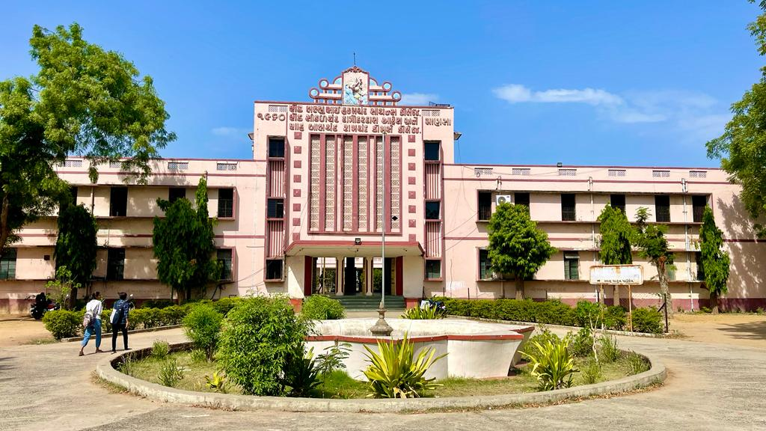
S.D.Arts and Shah B.R.Commerce College, Mansa

Slide 2
GUJARAT UNIVERSITY
B.A.SMESTER 3
ELECTIVE (EC 202)
WORLD HISTORY (FORM 1870 A.D. TO 1920 A.D.)

Slide 3
UNIT 1
Nationalism
Unification of Germany and Italy
Meiji Rule of japan and Modernization

Slide 4
UNIT 2
Chinese Revolution of 1911
World War 1: Cause and Effect
Paris peace Conference

Slide 5
Unit 3
Industrial Revolution : Meaning and Definition
Industrial Revolution : Causes
Industrial Revolution : Political, Social & Economic Effects

Slide 6
Unit 4
Russian Revolution of 1917
Causes and Effect on Russian and World
New Economic policy of Lenin

