Slide 1
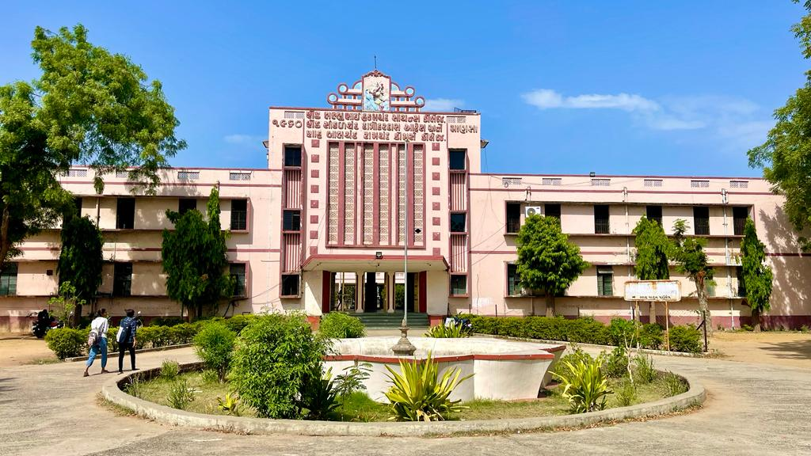
S.D.Arts and Shah B.R.Commerce College, Mansa

Slide 2
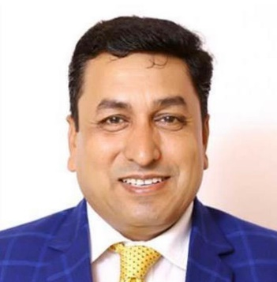
GUJARAT UNIVERSITY
B.A. (HONS) SEMESTER 2
ELECTIVE-111
ANCIENT INDIA : HISTORY, ARCHAEOLOGY, AND CULTURE(5th Century B.C to 650 A.

Slide 3
Unit 1
Chandragupta Maurya and Bindusara
Ashoka- Political and religious Policy
Mauryan Administration
Decline of Mauryan Empire

Slide 4
UNIT 2
Indian between 2nd B.C. to 3rd A.D.
Indo-Greek Rulers
Shakas and Pahalavas
Kushana Dynasty: Political, Administrative and Cultural Achievement of Kanishka

Slide 5
Unit 3
The Gupta Age
Chandragupta I and Samudragupta
Chandragupta Vikramaditya and Skandgupta
Huna’s Invasion and fall of the Gupta Empire.
The Gupta Administration
Cultural development during Gupta period

Slide 6
Unit 4
Post Gupta Period
Harshavardhana
Cultural Achievements of Harshavardhana
Hiuen-Tsang

