Slide 1
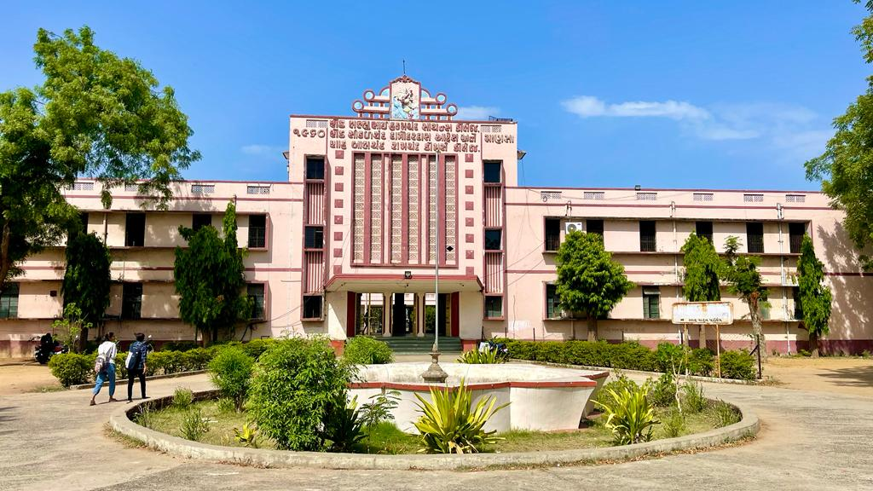
S.D.Arts and Shah B.R.Commerce College, Mansa

Slide 2
GUJARAT UNIVERSITY
B.A.SEMSTER 4
ELECTIVE (EC11 214)
FREEDOM STRUGGLE OF INDIA (1857-1947AD)

Slide 3
Unit 1
Causes of the Rise of Nationalism in India
Upheaval of 1857: Causes and Effects.
Major Leaders of 1857.

Slide 4
UNIT 2
Establishment of Indian National Congress: its early political Activities and Achievements (1885-1905).
Revolutionary Activities in India and Abroad.

Slide 5
Unit 3
Non Co-operation Movement of
Mahatma Gandhi (1920-22).
B. Civil Dis-obedience Movement of
Mahatma Gandhi (1930).

Slide 6
Unit 4
Quit India Movement (1942).
Indian national Army and the Role of Subhash
Chandra Bose in Freedom Struggle of India.

