Slide 1
S.D. Arts and Shah B.R. Commerce College, Mansa
Department of Psychology
Dr.Sonal N.Prajapati

Slide 2
Mental Health Problems of Adolescence

Slide 3
Introduction:-
Adolescence is a time of significant physical, social, and emotional development, and it is also a time when mental health problems can arise. Mental health problems can have a significant impact on the lives of young people, affecting their relationships, academic performance, and overall well-being. Unfortunately, stigma associated with mental health problems can create a barrier to seeking help, leaving many adolescents struggling in silence. However, with proper education, awareness, and access to effective treatment options, we can help prevent and address mental health problems in adolescence. This article will provide an in-depth exploration of the prevalence, symptoms, impact, and treatment of mental health problems in adolescence, as well as strategies for prevention and reducing stigma. By understanding the unique challenges facing young people and providing appropriate support and care, we can help promote positive mental health outcomes for this critical stage of development.

Slide 4
Adolescence
Adolescence is a transitional period between childhood and adulthood, typically spanning from ages 10 to 19 years old. This is a critical stage of development that is marked by significant physical, emotional, and social changes. During adolescence, individuals experience rapid physical growth, hormonal changes, and cognitive development.
Physically, adolescence is marked by significant changes in height, weight, and body composition. Adolescents may experience puberty during this period, which is characterized by the development of secondary sexual characteristics such as the growth of pubic hair, breast development in females, and deepening of the voice in males. Adolescents may also experience an increase in muscle mass and bone density, which can contribute to improved physical performance.
Emotionally, adolescence can be a challenging time as individuals navigate a range of emotions, including excitement, anxiety, and self-doubt. Adolescents may struggle with identity formation and social pressures, which can contribute to mood disorders such as depression and anxiety.
Socially, adolescence is marked by significant changes in relationships and social roles. Adolescents may seek greater independence from their parents and form relationships with peers. They may also begin to explore romantic relationships and develop a stronger sense of their own values and beliefs.
Overall, adolescence is a critical period of development that can have a lasting impact on an individual's physical, emotional, and social well-being. Understanding the unique challenges and opportunities of this period can help parents, caregivers, and professionals support adolescents as they navigate this important stage of life.

Slide 5
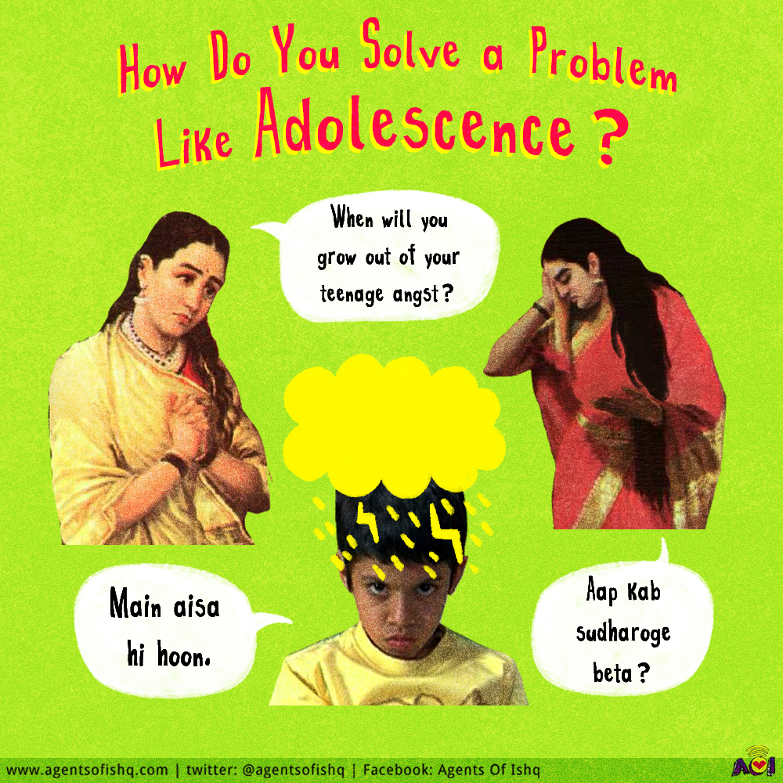

Slide 7
The World Health Organization defines mental health as a “state of well-being whereby individuals recognize their abilities, are able to cope with the normal stresses of life, work productively and fruitfully, and make a contribution to their communities.” Applying such adult based definitions to adolescents and identifying mental health problems in young people can be difficult, given the substantial changes in behavior, thinking capacities, and identity that occur during the teenage years. The impact of changing youth subcultures on behavior and priorities can also make it difficult to define mental health and mental health problems in adolescents. Although mental disorders reflect psychiatric disturbance, adolescents may be affected more broadly by mental health problems.
Factors that can impact mental health include genetic, biological, environmental, and social factors. Mental health problems can range from mild to severe and can include conditions such as anxiety, depression, bipolar disorder, and schizophrenia.
It is important to prioritize mental health and seek appropriate support and treatment when needed. This can involve a range of interventions, including therapy, medication, lifestyle changes, and social support. With proper care and attention, individuals can maintain good mental health and lead fulfilling lives.

Slide 8
Adolescence is a time of significant change and development, and mental health problems are common during this period. According to the World Health Organization (WHO), it is estimated that approximately 10-20% of adolescents worldwide experience mental health problems. The prevalence of mental health problems can vary depending on the country and the population studied, but several studies suggest that mental health problems are on the rise among adolescents globally.
Prevalence:-
Anxiety disorders are the most common mental health problems among adolescents, affecting approximately 10-20% of young people. Symptoms of anxiety can include excessive worry, difficulty concentrating, irritability, restlessness, and sleep disturbances. Social anxiety disorder, specific phobias, and generalized anxiety disorder are some of the most common types of anxiety disorders among adolescents.
Depression is also a significant mental health problem among adolescents. According to a study published in the Journal of Adolescent Health, approximately 14% of adolescents experience a major depressive episode by the age of 18. Symptoms of depression can include persistent sadness, feelings of worthlessness or hopelessness, loss of interest in activities, changes in appetite or sleep, and thoughts of self-harm or suicide.
Substance use disorders are also common among adolescents, with approximately 4-7% of young people meeting criteria for a substance use disorder. Substance use can lead to a range of negative outcomes, including impaired cognitive functioning, poor academic performance, and increased risk of injury or death.

Slide 9
Other common mental health problems among adolescents include eating disorders, obsessive-compulsive disorder (OCD), and post-traumatic stress disorder (PTSD). Eating disorders, such as anorexia and bulimia, affect approximately 2-3% of adolescents and can lead to serious medical complications. OCD affects approximately 1-2% of adolescents and can cause persistent and intrusive thoughts, as well as repetitive behaviors. PTSD can develop following exposure to a traumatic event and can cause symptoms such as flashbacks, nightmares, and hyperarousal.
It is important to note that mental health problems often co-occur, with adolescents experiencing multiple disorders simultaneously. For example, a young person with depression may also experience symptoms of anxiety or substance use. This can make treatment more complex and highlights the importance of comprehensive mental health assessments.
Overall, the prevalence of mental health problems among adolescents is a significant public health concern. Early identification and intervention are crucial in promoting positive mental health outcomes and improving the overall well-being of young people.

Slide 10
Biological Changes:-
Adolescence is a period of significant biological changes, including changes in brain development, hormonal changes, and changes in sleep patterns. These changes can affect emotional regulation, decision-making, and risk-taking behaviors. Here are some elaborative details about the biological changes that occur during adolescence:
Brain Development: The brain undergoes significant changes during adolescence, with ongoing development continuing into early adulthood. The prefrontal cortex, which is responsible for decision-making, impulse control, and planning, continues to develop during adolescence. This means that adolescents may have difficulty with impulse control and making informed decisions. At the same time, the limbic system, which is responsible for emotions, motivation, and reward, undergoes significant changes. This can make adolescents more susceptible to emotional and impulsive behavior.
Hormonal Changes: Adolescence is also marked by significant hormonal changes, including the release of gonadal hormones, such as estrogen and testosterone. These hormones play a role in sexual maturation and can lead to physical changes such as the development of secondary sexual characteristics. However, they can also contribute to changes in mood and behavior. For example, fluctuations in estrogen levels may contribute to premenstrual mood changes in adolescent girls.

Slide 11
3. Sleep Patterns: During adolescence, there is a shift in sleep patterns, with a tendency towards later bedtimes and later waking times. This is due to changes in the circadian rhythm, which regulates sleep-wake cycles. This shift in sleep patterns can lead to sleep deprivation, which can affect mood, cognitive functioning, and overall health.
4. Reward Processing: Adolescents may also be more sensitive to reward stimuli, such as social approval or the experience of pleasure. This can make them more likely to engage in risk-taking behaviors, such as substance use, sexual activity, or reckless driving.
It's important to note that these biological changes are not the sole determinants of adolescent behavior and mental health. Environmental factors, such as family relationships, peer pressure, and academic stress, can also play a significant role in shaping adolescent development. Understanding the biological changes that occur during adolescence can help to promote positive mental health outcomes and support healthy development.

Slide 12
Environmental Factors:-
Adolescence is a period of significant developmental changes, and environmental factors can play a crucial role in shaping a young person's development and mental health outcomes.
Family Relationships: Family relationships play a significant role in shaping adolescent development. Positive and supportive family relationships can promote healthy development, whereas negative or dysfunctional relationships can contribute to a range of mental health problems, such as depression, anxiety, and conduct disorder. Family factors such as parental support, communication, and warmth have been shown to be associated with positive mental health outcomes in adolescents.
Peer Relationships: Adolescents also have a strong need for social acceptance and approval, and peer relationships can play a significant role in shaping behavior and mental health outcomes. Positive peer relationships can provide social support and promote healthy development, whereas negative peer relationships, such as bullying or social exclusion, can contribute to a range of mental health problems. Peer factors such as peer pressure and peer victimization have been shown to be associated with negative mental health outcomes in adolescents.

Slide 13
Academic Stress: Academic stress is a common environmental factor that can impact adolescent development. The pressure to perform well academically can lead to high levels of stress, anxiety, and depression in some adolescents. Academic stress can also lead to a range of negative outcomes such as poor academic performance, decreased self-esteem, and burnout.
Community Factors: The environment in which adolescents live can also play a significant role in shaping their development and mental health outcomes. Environmental factors such as poverty, violence, and discrimination can contribute to a range of mental health problems such as depression, anxiety, and post-traumatic stress disorder. Community factors such as access to resources, safety, and social support have been shown to be associated with positive mental health outcomes in adolescents.
Technology: Technology is increasingly becoming a part of adolescents' daily lives, and it can have both positive and negative impacts on mental health outcomes. Social media and online communication can provide social support and promote positive self-image, but it can also contribute to negative outcomes such as cyberbullying, social comparison, and addiction.
Overall, environmental factors play a significant role in shaping adolescent development and mental health outcomes. It is important to recognize and address these factors to promote positive mental health outcomes and support healthy development in young people.

Slide 14
Symptoms:-
Mental health problems in adolescence can manifest in a variety of ways, and the symptoms may differ depending on the specific disorder.
Mental health problems and disorders in adolescents.
Problem or disorder | Prevalence (%)
Common
Depression | 3-5
Anxiety | 4-6
Attention-deficit/hyperactivity disorder | 2-4
Eating disorders | 1-2
Conduct disorder | 4-6
Substance misuse disorder | 2-3
Less common
Panic disorder | 1-2
Post-traumatic stress disorder | 1-2
Borderline personality disorder | 1-3
Schizophrenia | 0.5
Autistic spectrum disorders (such as autism, Asperger's syndrome) | 0.6

Slide 15
Symptoms needing assessment:-
• Signs of overt mood depression (low mood, tearfulness, lack of interest in usual activities)
• Somatic complaints such as headache, stomach ache, backache, and sleep problems
• Self harming behaviours
• Aggression
• Isolation and loneliness
• Deviant behaviour such as theft and robbery
• Change in school performance or behaviour
• Use of psychoactive substances, including over the counter medications
• Weight loss or failure to gain weight with growth

Slide 16
Depression:-
The recognition, evaluation, and treatment of depression and related suicidal or self harming behavior are the highest priorities in adolescent mental health. Epidemiological studies suggest that at any one time 8% to 10% of adolescents have severe depression. This means that the major burden of assessing and managing adolescent depression falls on primary care practitioners.
Signs and symptoms of severe depression*
• Persistent sad or irritable mood
• Loss of interest in activities once enjoyed
• Substantial change in appetite or body weight
• Oversleeping or difficulty sleeping
• Psychomotor agitation or retardation
• Loss of energy
• Feelings of worthlessness or inappropriate guilt
• Difficulty concentrating
• Recurrent thoughts of death or suicide
Five or more of these symptoms (including at least one of the first two) must persist for two or more weeks before major depression can be diagnosed

Slide 17
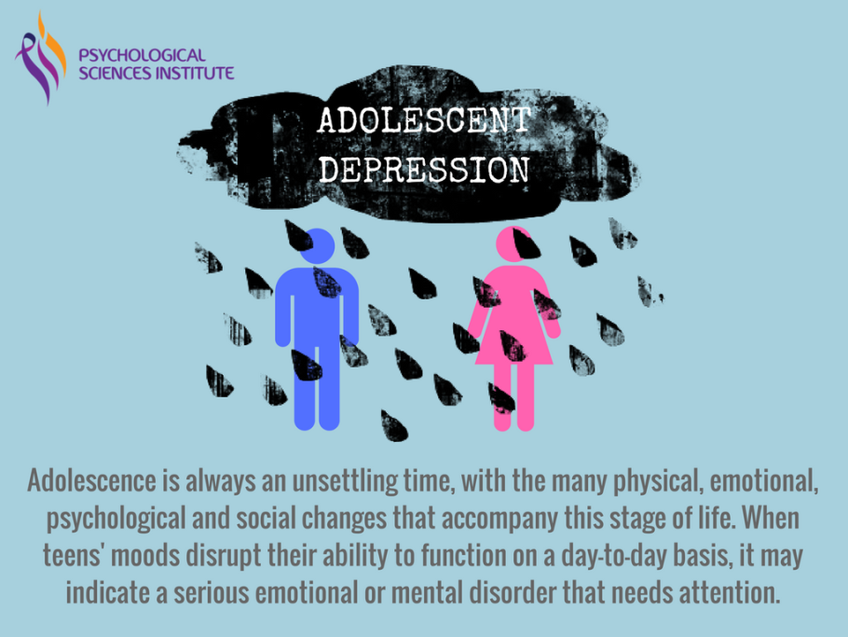
.
It's important to note that mental health problems in adolescents can have a significant impact on their daily functioning, relationships, and overall quality of life. Early recognition and treatment of symptoms can help prevent long-term negative outcomes and promote positive mental health outcomes. If you or someone you know is experiencing symptoms of a mental health problem, it's important to seek professional help.

Slide 18
Treatment:-
Effective treatment options for mental health problems in adolescence depend on the specific disorder and the individual's needs.
Psychotherapy: Also known as talk therapy or counseling, psychotherapy is a treatment option that involves talking with a trained mental health professional about thoughts, emotions, and behaviors. Psychotherapy can help adolescents understand their mental health problems, develop coping strategies, and learn healthy ways to manage symptoms. Types of psychotherapy commonly used in adolescence include cognitive-behavioral therapy (CBT), dialectical behavior therapy (DBT), and interpersonal therapy (IPT).
Medication: Medications can be prescribed by a psychiatrist or other mental health professional to help manage symptoms of certain mental health disorders, such as depression, anxiety, or bipolar disorder. The type of medication prescribed will depend on the specific disorder and individual needs, and medication is often used in combination with other treatment options such as psychotherapy.

Slide 19
Family therapy: Family therapy involves working with the entire family to improve communication, resolve conflicts, and support the adolescent with mental health problems. Family therapy can be particularly helpful for disorders that impact family dynamics, such as eating disorders or substance use disorders.
Group therapy: Group therapy involves working with a group of peers who are experiencing similar mental health problems. Group therapy can provide a supportive and non-judgmental environment for adolescents to discuss their experiences, learn coping strategies, and receive emotional support.
Supportive interventions: Supportive interventions such as art therapy, music therapy, or mindfulness-based interventions can also be effective treatment options for mental health problems in adolescence. These interventions can help adolescents express themselves in creative ways, reduce stress and anxiety, and improve overall well-being.

Slide 20
Lifestyle changes: Lifestyle changes such as exercise, healthy eating habits, and good sleep hygiene can also be effective treatment options for mental health problems in adolescence. These changes can improve overall physical and emotional health reduces stress, and helps manage symptoms of mental health problems.
Overall, effective treatment options for mental health problems in adolescence involve a combination of interventions tailored to the individual's needs and specific disorder. It's important for adolescents and their families to work with a trained mental health professional to determine the most appropriate treatment plan for their needs.

Slide 21
Conclusion:-
In conclusion, adolescence is a crucial stage of development that can bring significant physical, social, and emotional changes. Unfortunately, mental health problems can also arise during this time, and they can have a significant impact on young people's lives if left unaddressed. However, there are many effective treatment options available, including therapy, medication, and lifestyle changes, that can help adolescents manage their mental health symptoms and improve their overall well-being.
Moreover, prevention strategies such as education and awareness campaigns, positive parenting practices, early intervention, healthy lifestyle habits, and community involvement can help reduce the risk of mental health problems in adolescence and promote positive mental health outcomes.
It is also crucial to address stigma associated with mental health problems, as it can create significant barriers to seeking help and receiving appropriate care. By challenging negative attitudes and beliefs surrounding mental illness, we can help create a more supportive environment for young people and ensure that they receive the care and support they need to thrive.
Ultimately, by prioritizing mental health in adolescence, we can help set the stage for a lifetime of positive mental health outcomes and improve the lives of young people today and in the future.

