Slide 1
PARTS OF SPEECH
Dr. A.K. Patel,
Associate Professor, Department English, S.D. Arts & Shah B.R. Commerce College, Mansa

Slide 5
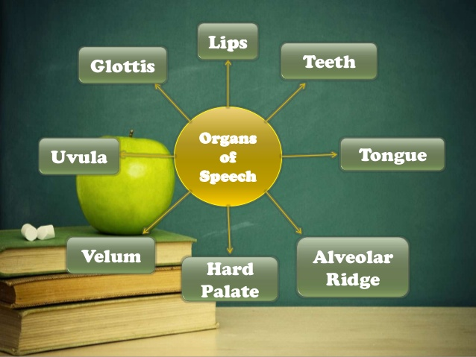

Slide 7
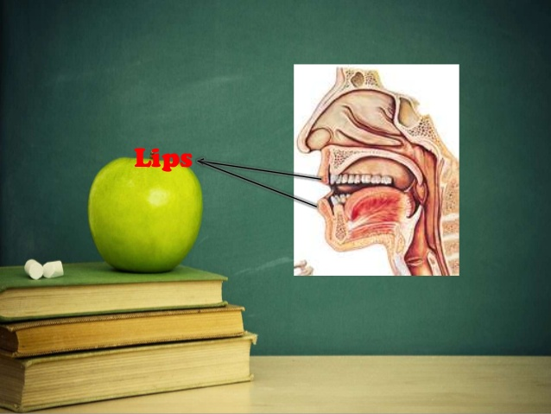

Slide 10
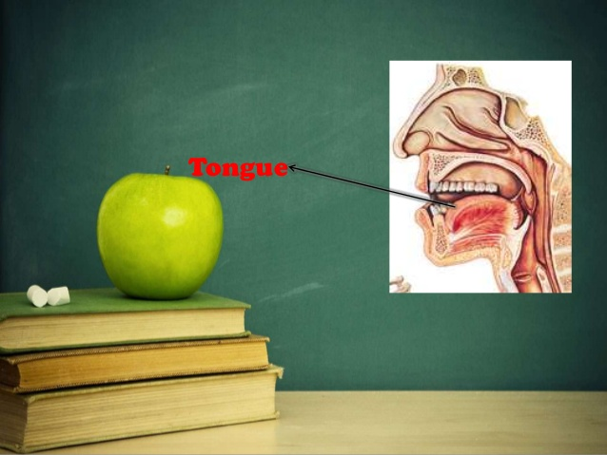

Slide 12
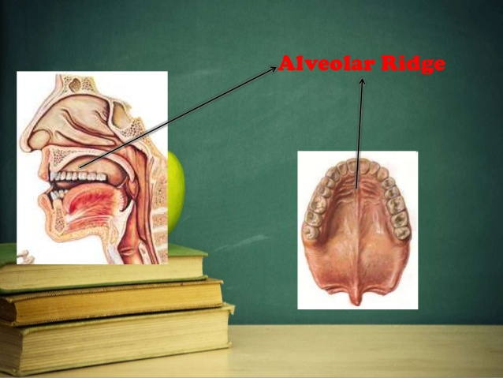

Slide 13
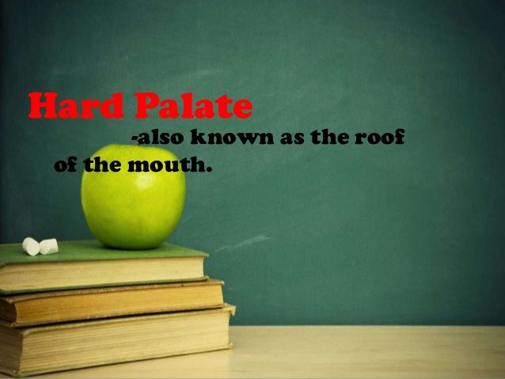

Slide 14
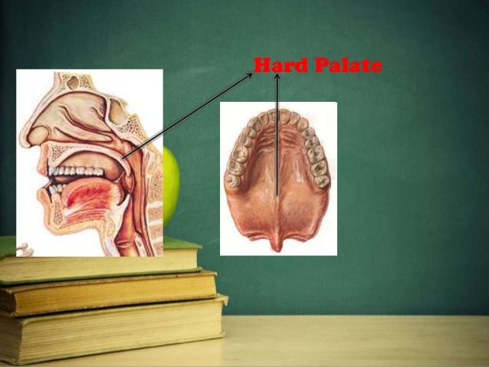

Slide 16
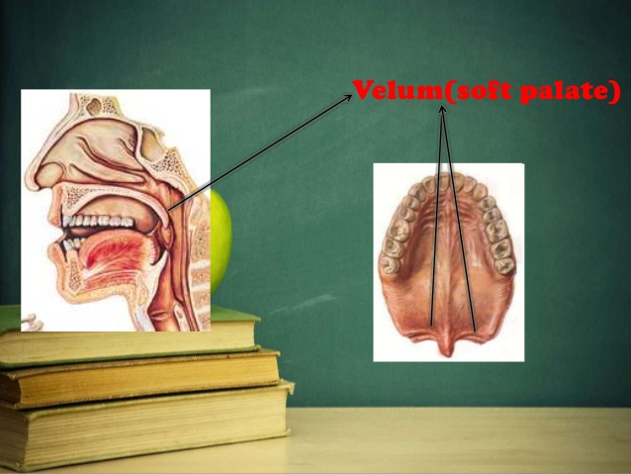

Slide 18
